Slide 1
Java FLP Project
Capgemini MIPL
21th August, 2018

Slide 2
CapStore
(E-Commerce Application)
Notes:
Usar para separador de capitulos . Seria bom ter esta versao em vermelho e verde tb..

Slide 3
:
Modules Assigned
12. Managing Inventory
13. Managing Merchants
14. Managing Third Party Merchants
15. Feedback of Products
16. Feedbacks Common

Slide 4
Product Feedbacks
by
Ramya U

Slide 5
Significance of the module:
Customers can give their product feedbacks in product page under every product.
Customer feedback should be displayed under the product once customer posts the comments along with rating.
Feedback Id will be generated uniquely for each feedback.
Notes:
Fixar a posicao do titulo – sempre do lado esquerdo.
Sempre que tiver muito texto o coluna deve sempre ser “ narrowed” , se nao fica dificil de ler. Colocar paragrafos no texto.
Linha vertical deve ser mais fina e as pontas NUNCA devem ser arredondadas.

Slide 6
RELATIONSHIPS WITH OTHER TABLES
INVENTORY
Feedback_Id
Customer_
Id
Product_
Id
Merchant_
Id
Comments
Prod_Rating
CUSTOMER
MERCHANT
INVENTORY
Notes:
Fixar a posicao do titulo – sempre do lado esquerdo.
Sempre que tiver muito texto o coluna deve sempre ser “ narrowed” , se nao fica dificil de ler. Colocar paragrafos no texto.
Linha vertical deve ser mais fina e as pontas NUNCA devem ser arredondadas.

Slide 7
Feedback Table
COLUMN_NAME | DATATYPE | KEY CONSTRAINTS | DESCRIPTION
feedback_Id | Integer | Primary Key | Unique for each feedback
customer_Id | Integer | Foreign Key | Fetched from Customer Table.
product_Id | Integer | Foreign Key | Fetched from Product Table.
merchant_Id | Integer | Foreign Key | Fetched from Merchant Table.
comments | String |  | For storing customer feedbacks.
product_Rating | Integer |  | Fetched for average rating.
status | String

Slide 8
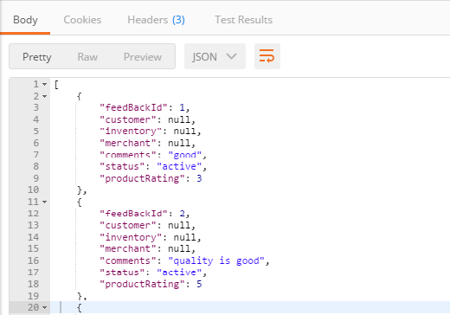
Back End

Slide 9
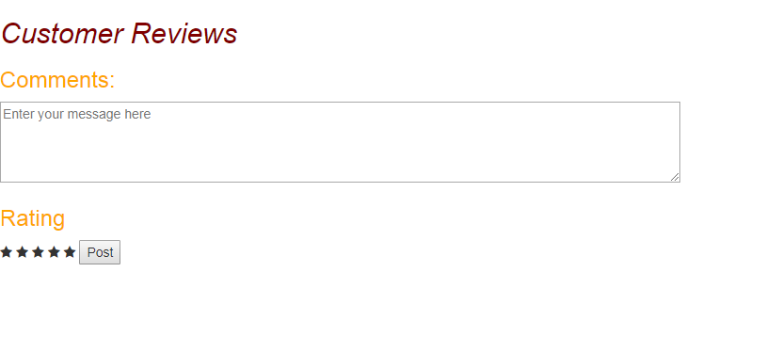
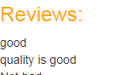
Front End

Slide 10
Thank You

